Slide 1
Weather Forecasting Using Ensemble Methods
Team : Weather_Dog(id:28)
If the flap of a butterfly’s wings can be instrumental in generating a tornado, it can equally well be instrumental in preventing a tornado
- Ed Lorenz

Slide 2
Problem definition
Weather Forecasting ( Temperature , Humidity) is problem involving high amount of uncertainty .
Model Problem Definition :-
Identify Features
Model to incorporate uncertainty ( Parameter tuning based on Different Conditions)
Generic Feature Sets for Different Cities
Final Results
Architecture for a Real Time Solution
How to build a system that changes the parameter as per the changes in data streaming from different sensors .
Sampling Mechanism
Uncertainty Driven Parameter Tuning.
Incorporates Uncertainty
Deployment
Uncertainty is the main problem component rather then static accuracy on a time window ?

Slide 3
Features
Existing Features ( Discretized Using Dummy-Encoding)
Additional Features for Experiment considered :-
1. Sea Surface Temperature
2. Carbon Footprint data
3. #Industries/ acre
4. Any Forest fire near by in the date.
5. Population density
6. Forest Area
Methods
1. Sample randomly on different time windows using MCMC technique
2. Build a Model based on Time Windows
3. Result on Test Set ( RMSE , R^2)

Slide 4
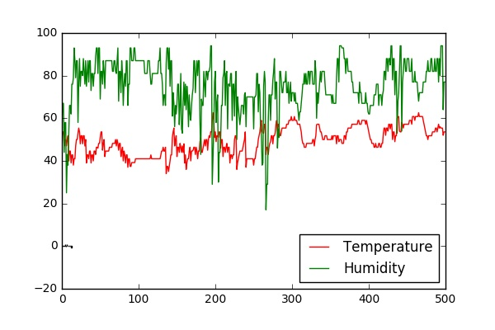
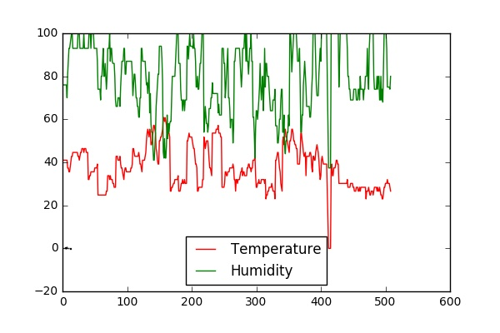
Exploratory Analysis
Barcelona
Ohio
Mean Variance analysis of Temp , Humidity Across different cities not constant.
Test What kind of Process the Time Series follows ? - Mean Reversion , Auto-Regression Tests.
How many Sliding Window Kernels have random jumps , higher variances based on a window of 100 days , 90 days ?

Slide 5
Model to incorporate both Distribution and Trend
Sliding Window KL-Divergence
- Simulate Distributions ( q-Gaussians , Gaussians)
- KL- divergence Varies widely [0.0 – 909.01]
- Method1 : Minimize KL-Divergence
RMSE-Scores
- Linear Regression Based Models ( Optimize RMSE)
Does weather follow Markovian Property ?
- Tackling Uncertainty Using MCMC methods.
Ensemble Methods for Optimizing KL-Divergence , RMSE and sampling mechanism to undertake uncertainty.

Slide 6
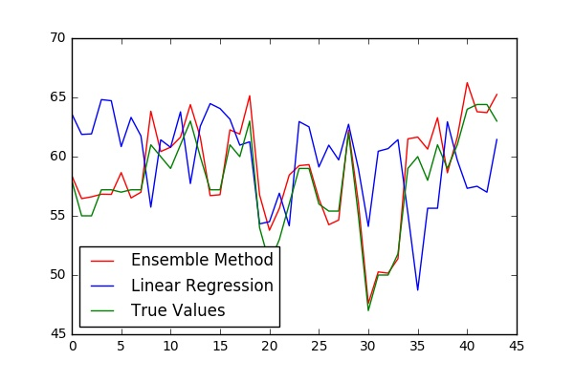
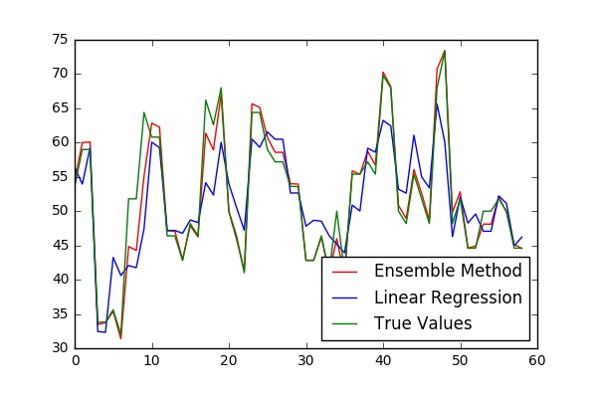
Results
Barcelona
Ohio
Ensemble RMSE : 4.95403035086
Linear Regression RMSE : 27.2686032919
Ensemble RMSE : 2.27628567731
Linear Regression RMSE : 30.4900764217

Slide 7
Next Steps Algorithms for Stable Real Time Prediction Systems
Automate Parameter Tuning – [ Input – Latitude , Time-Windows]
Seed()
Select window size ( random)
Initialize an Ensemble , Parameters : Step-Size , Beta ( for fitting) , Number of moves
Repeat till convergence
Use Model for Prediction in a time –window.
Trigger values for ( Error , higher Jumps)
Deploy in a Fast Data Architecture

